Slide 1
1st steps into 3D modelling with Rhino
PGCert Microteach || February 2025

Slide 2
Setting the context
Introduction
You
PGCerters thinking about Design students
Beginners – having never used Rhino 3D
2
Notes:
Design is taken in a broad sense, but the main target audiences are students in PFD, Interior and spatial design, architecture
I will be running this in a hybrid way: You are placed in the shoes of students but I will sometimes narrate what I would deliver in a regular classroom, that is to maybe points towards more targeted feedback
2

Slide 3
In this session
Introduction
Objectives
Overcome fear of learning a new software
Learn technical aspects without noticing
Get a hold of the interface, ways to call basic commands, and from the first session, establish good practice workflows
3
Notes:
Learning a new software can be intimidating, my point is to helps students from the first session get a hands on approach that will hopefully give them confidence to keep learning
I want them to learn through practice from the start, and forget about technical aspects of the software itself –that is to an extent, they should be diluted amongst practical elements
Workflows are fundamental
Often I focus the first sessions on using Rhino as part of a fabrication process – here it is a digital one, aiming at 3D printing the model
3

Slide 4
In this session
Introduction
Strategy
Oversimplification
Place the students within a practical scenario
Build a model, ready to be used or printed, in their first session
Show the outcome first, recap at the end
Bringing the virtual space to the physical one through props
4
Notes:
Outcome first: they are work towards an object, I am placing them in a situation they would encounter when conceiving and designing. In that sense I will show them how the software sits withing their workflow, how and when they will use it.
4

Slide 5
Before we open Rhino

Slide 6
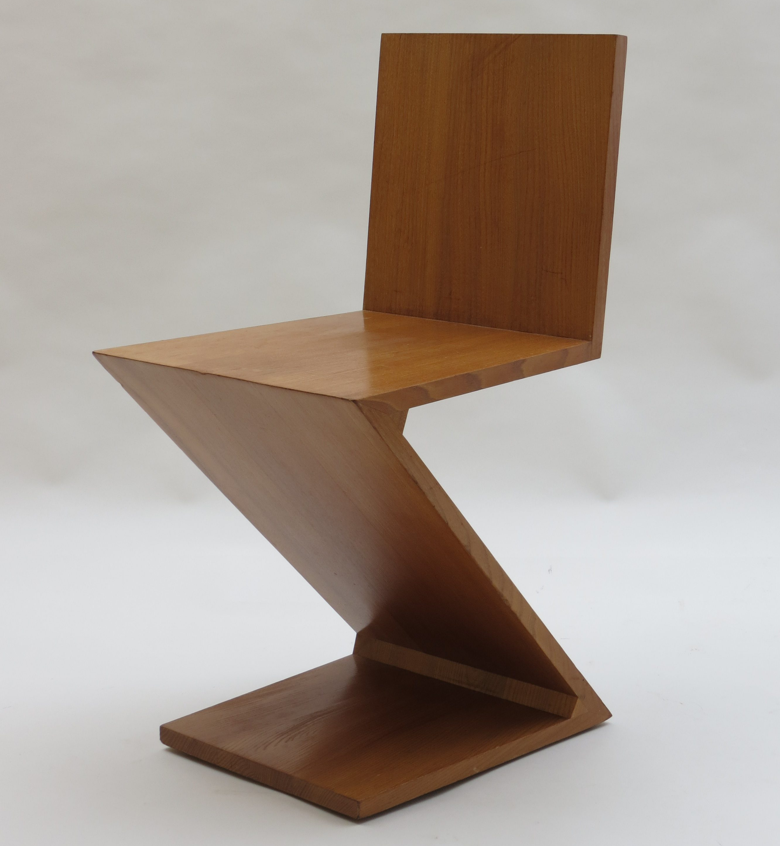
Before we open Rhino
Before you start – set a strategy
I want to design this simple chair for a scene where it won’t be too visible.
Can you think of the minimum commands I could use to get this volume?
I want to design this Zigzag chair to :
3D print at a small scale
Or
Use in a scene where it won’t be too visible
6
Notes:
Zig Zag Chair By Gerart Rietveld 1934
6

Slide 7
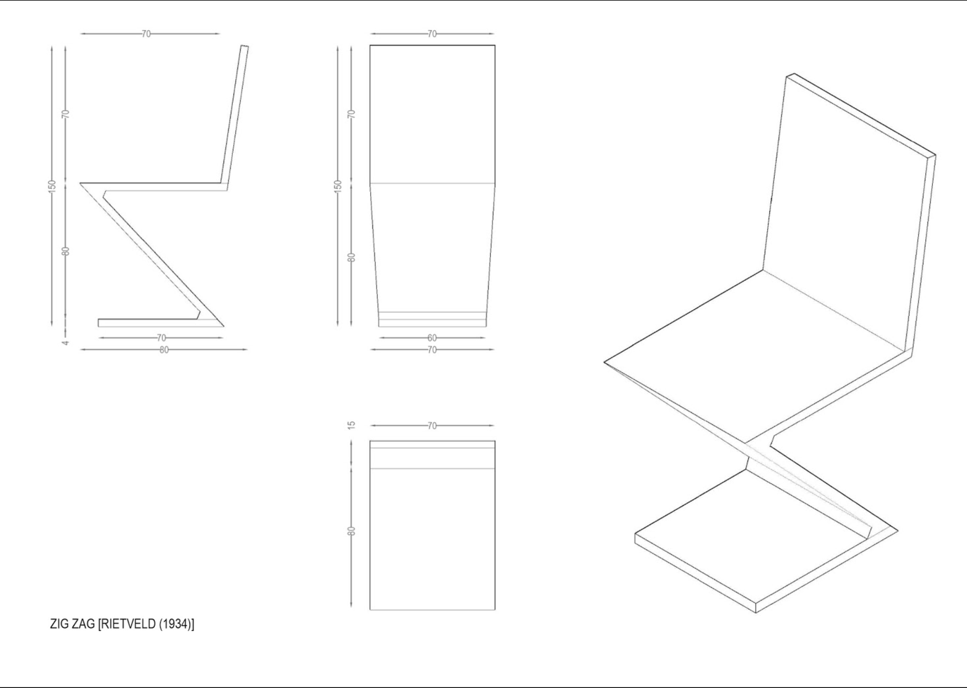
Before we open Rhino
The material that we found - Zig Zag Chair, Rietveld (1934)
I want to design this simple chair for a scene where it won’t be oo visible.
Can you think of the minimum commands I could use to get this volume?
7
Notes:
I found in the library these technical drawings which I scanned to help me build my model
7

Slide 8
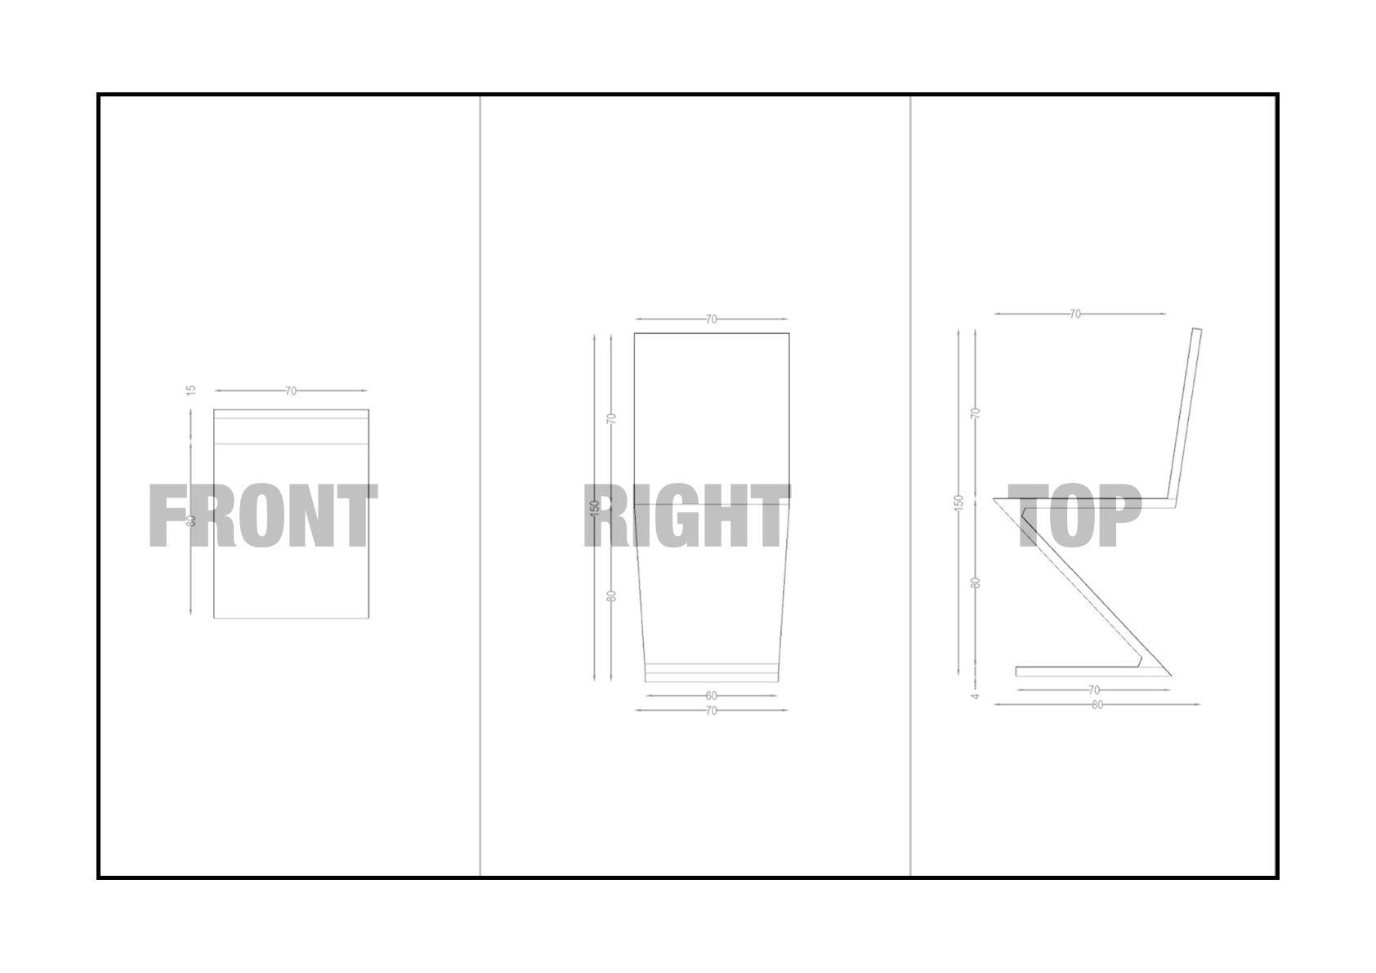
Before we open Rhino
Can you guess the projection views?
I want to design this simple chair for a scene where it won’t be oo visible.
Can you think of the minimum commands I could use to get this volume?
8
Notes:
Give each student a board and projection views to place in the correct elevation view
8

Slide 9
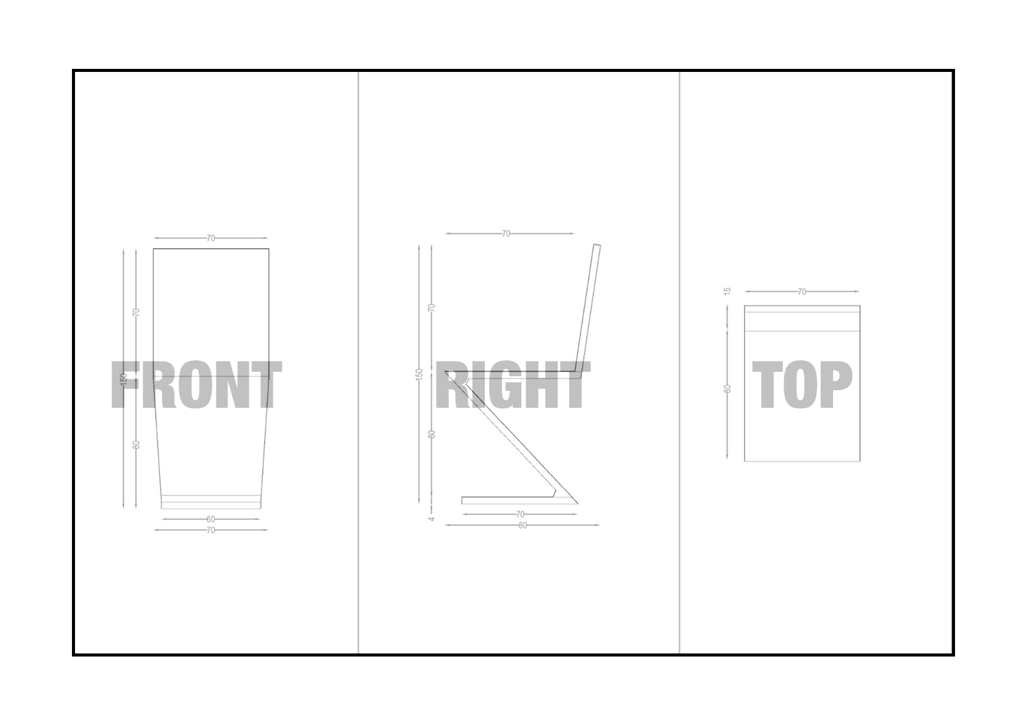
Before we open Rhino
Can you guess the projection views?
I want to design this simple chair for a scene where it won’t be oo visible.
Can you think of the minimum commands I could use to get this volume?
9
Notes:
These views that we all guessed, I will find the same ones In Rhino’s default viewports
9

Slide 10
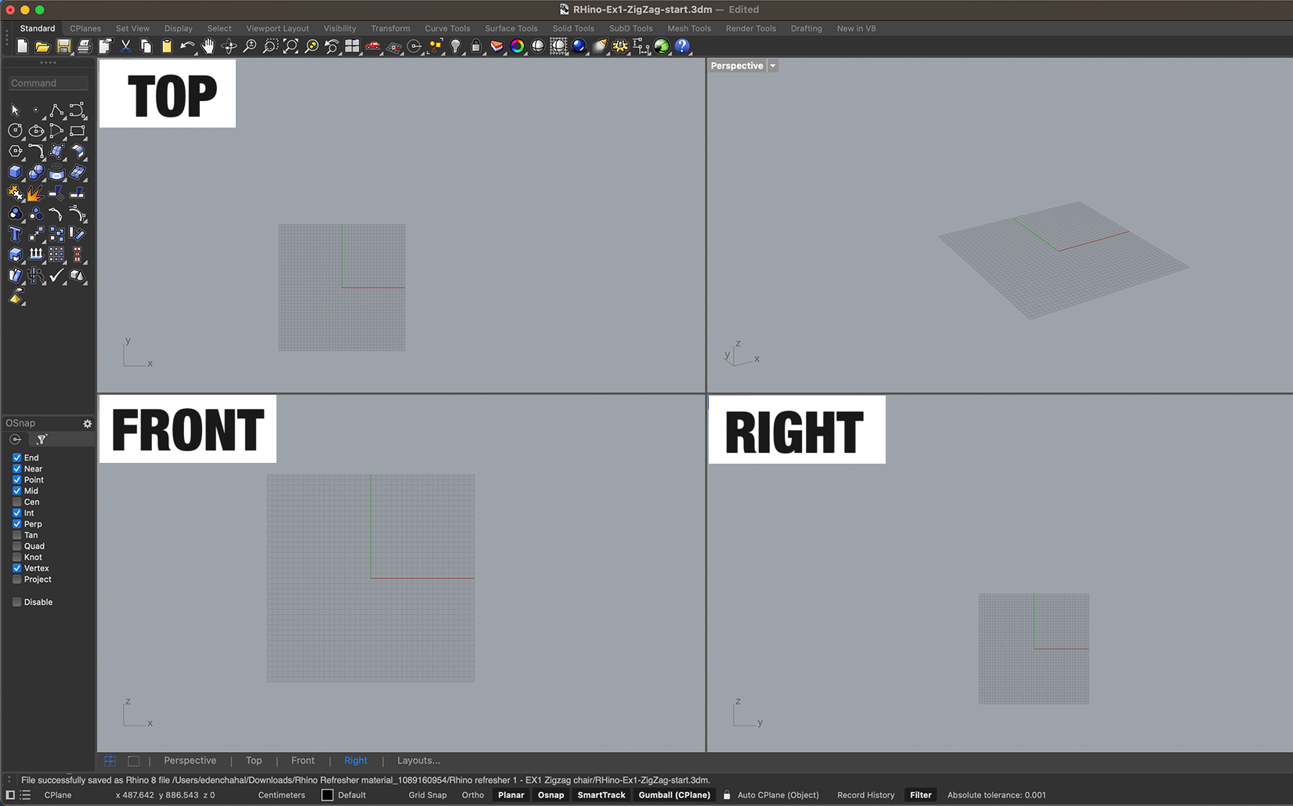
Before we open Rhino
In Rhino’s interface – construction planes
I want to design this simple chair for a scene where it won’t be oo visible.
Can you think of the minimum commands I could use to get this volume?
10
Notes:
These views that we all guessed, I will find the same ones In Rhino’s default viewports - these can be customized but we will for this session use the default setting and navigate between the views
10

Slide 11
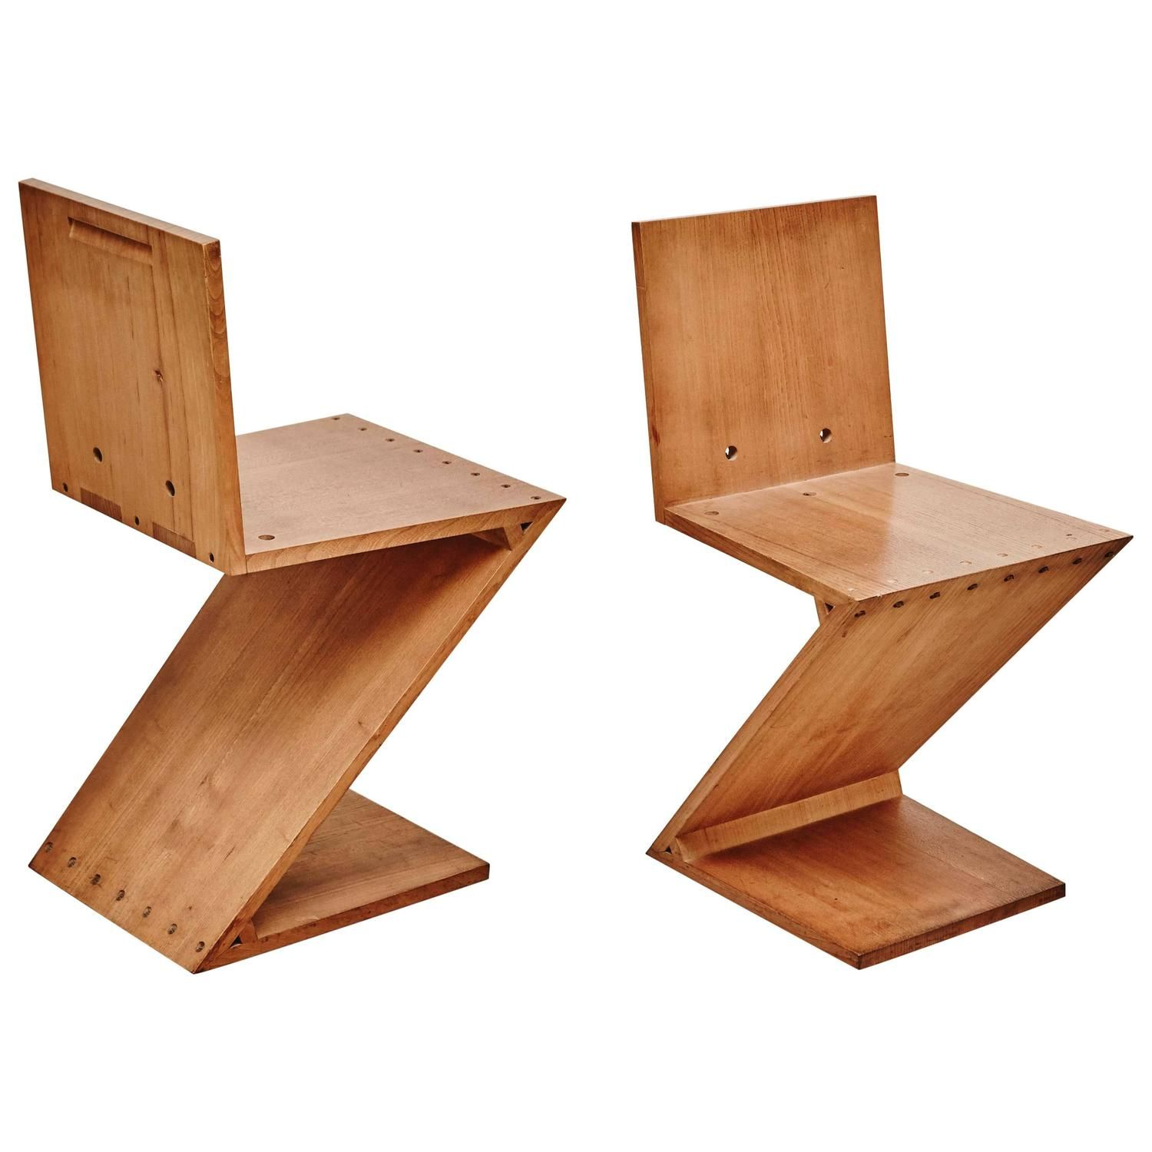
Before we open Rhino
Let’s analyse our chair – what defines its shape?
I want to design this simple chair for a scene where it won’t be oo visible.
Can you think of the minimum commands I could use to get this volume?
11
Notes:
We’ve analysed our material and we know how we are going to be using it, now we need to have a better look at our chair - how will we build it If you were to simplify it and place points that would define with the minimum points the shape of the chair where would you place them?
Have student place pins + Show the line with thread
11

Slide 12
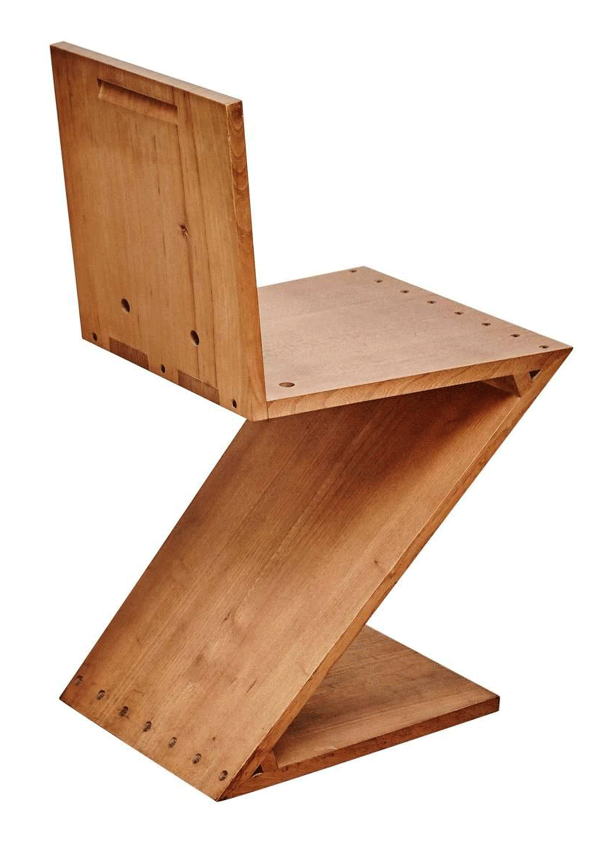
Before we open Rhino
The shape of the chair
I want to design this simple chair for a scene where it won’t be oo visible.
Can you think of the minimum commands I could use to get this volume?
12
Notes:
We’ve analysed our material and we know how we are going to be using it, now we need to have a better look at our chair - how will we build it If you were to simplify it and place points that would define with the minimum points the shape of the chair where would you place them?
12

Slide 13
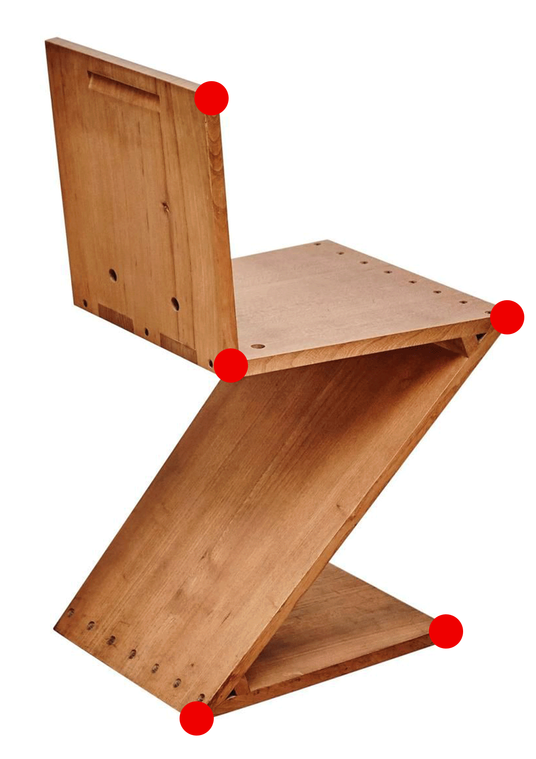
Before we open Rhino
The shape of the chair
I want to design this simple chair for a scene where it won’t be oo visible.
Can you think of the minimum commands I could use to get this volume?
13
Notes:
We’ve analysed our material and we know how we are going to be using it, now we need to have a better look at our chair - how will we build it If you were to simplify it and place points that would define with the minimum points the shape of the chair where would you place them?
13

Slide 14
Demonstration

Slide 15
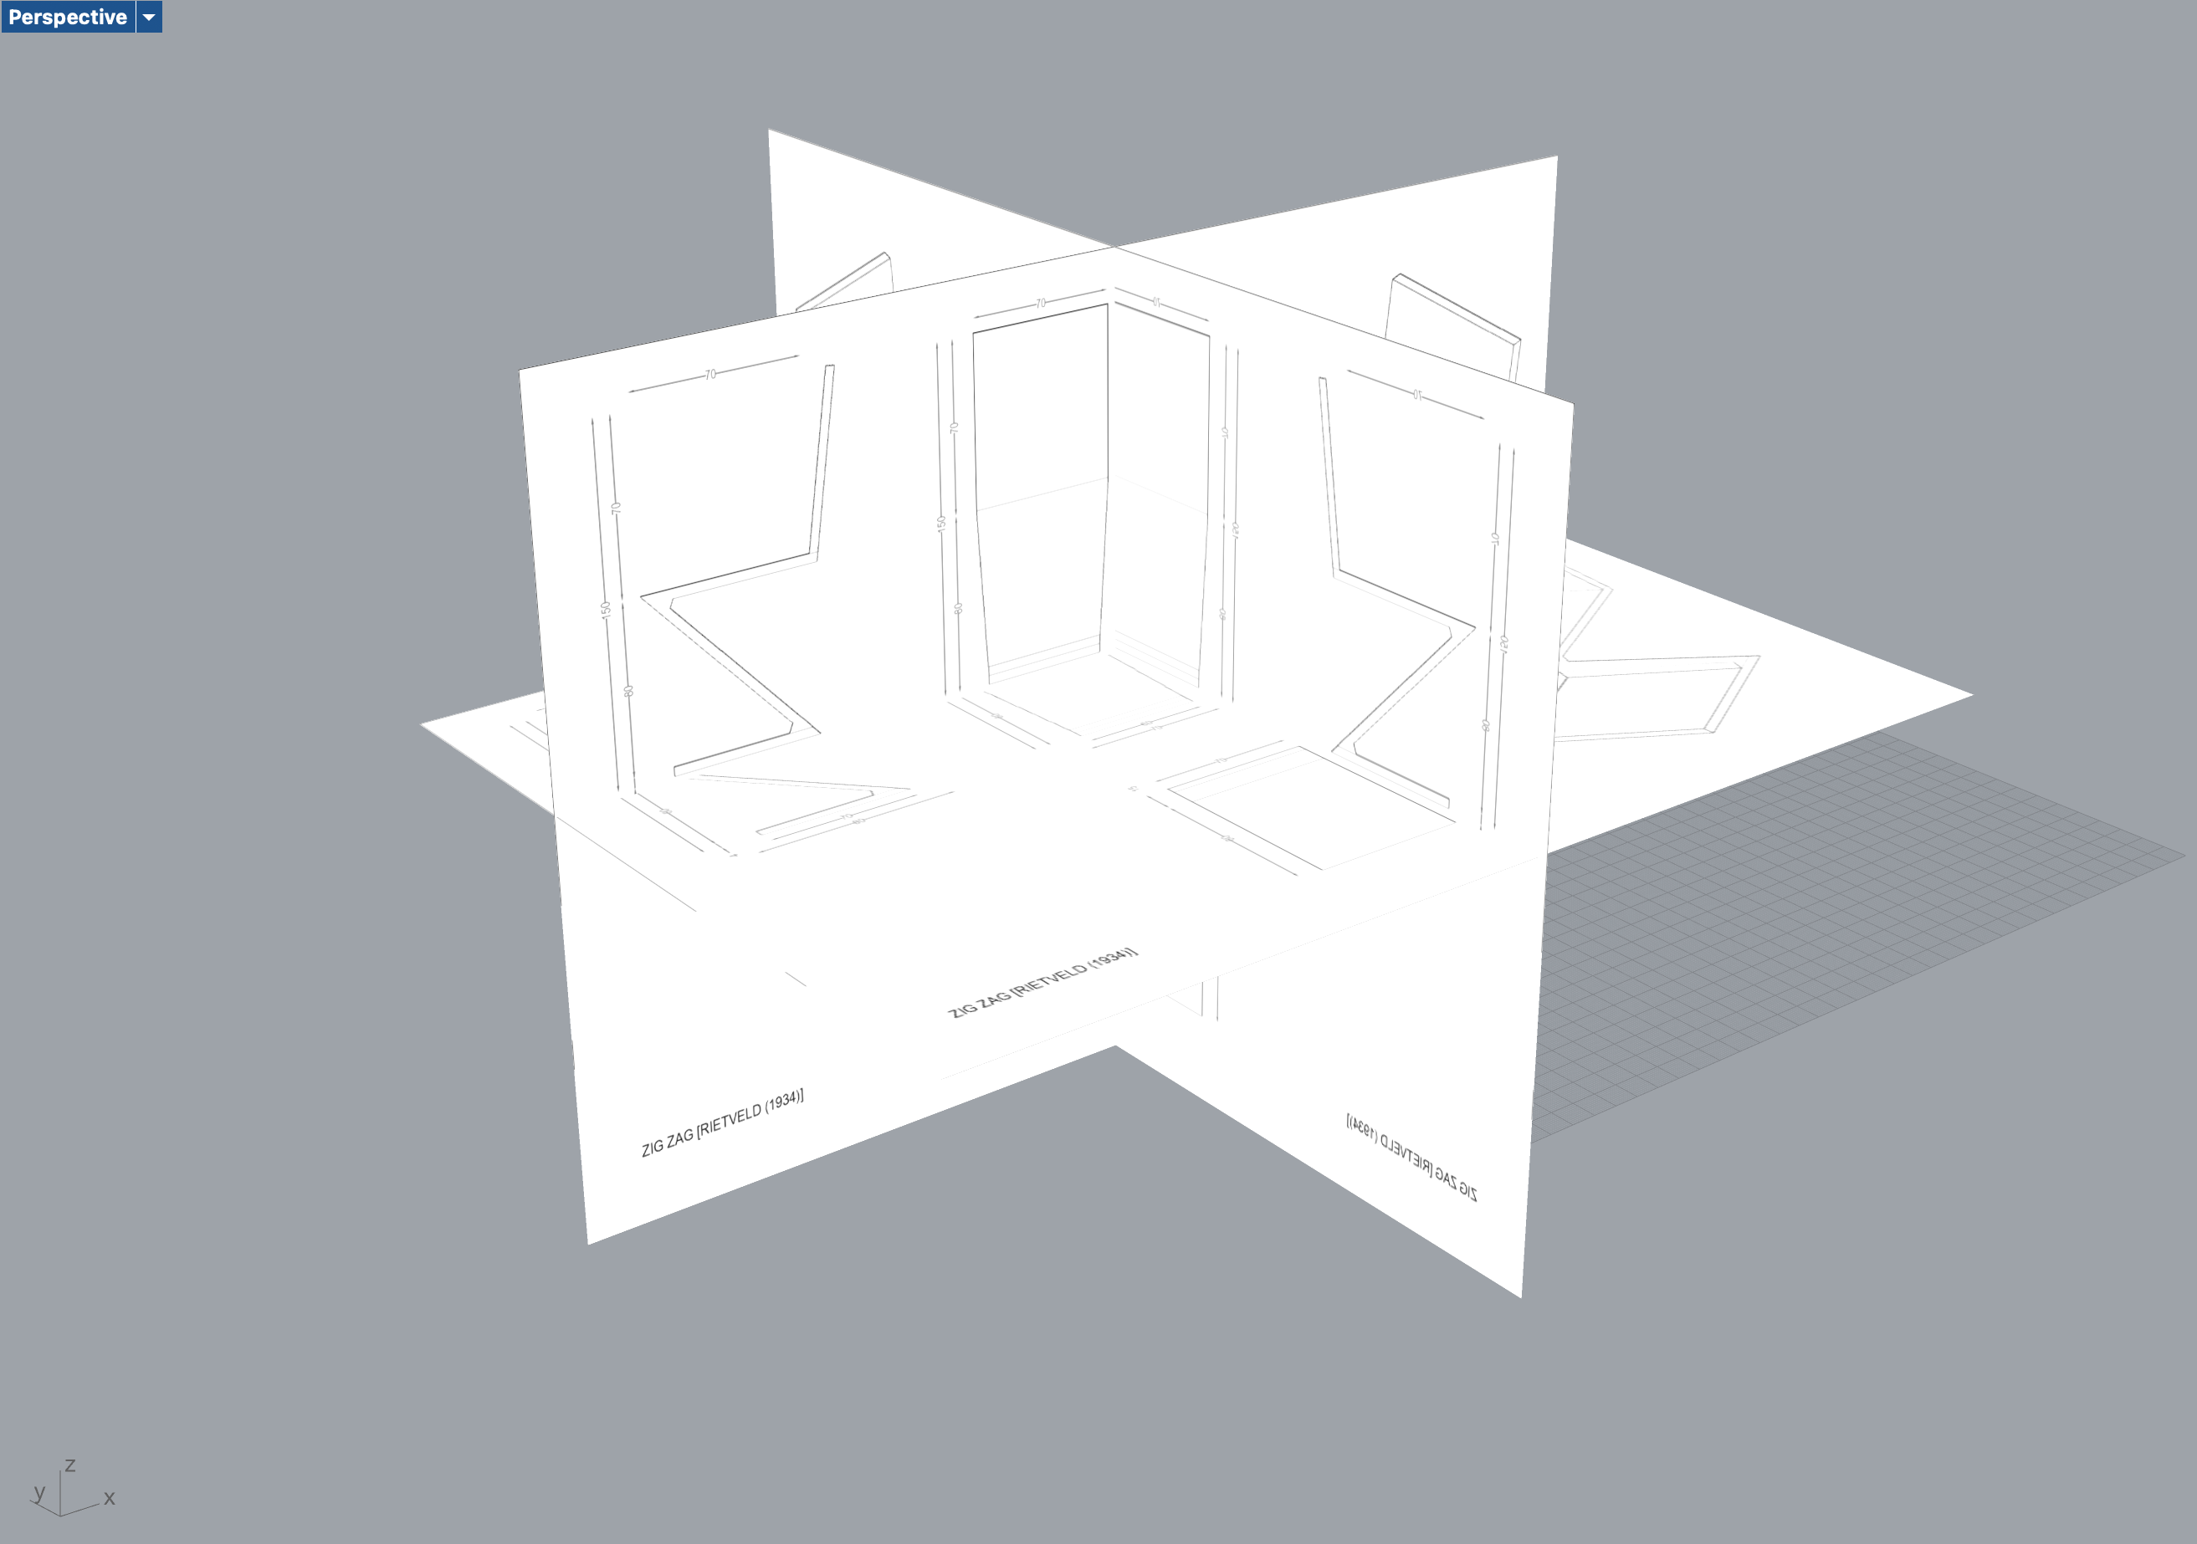
Let’s start modelling
In the start file in Rhino
I want to design this simple chair for a scene where it won’t be oo visible.
Can you think of the minimum commands I could use to get this volume?
15
Notes:
Students would have received this, a start file with the drawings placed in their correct scale and position ready to be used as helpers for their modeling
Show how I would model it – At this point student wouldn’t have opened the software yet, I want them to pay attention to the full process first
15

Slide 16
Recap

Slide 17
What we have learnt
Recap
Viewports
17
Notes:
To avoid overloading the slides with text, use speaker notes to add more detail and prompts.
17

Slide 18
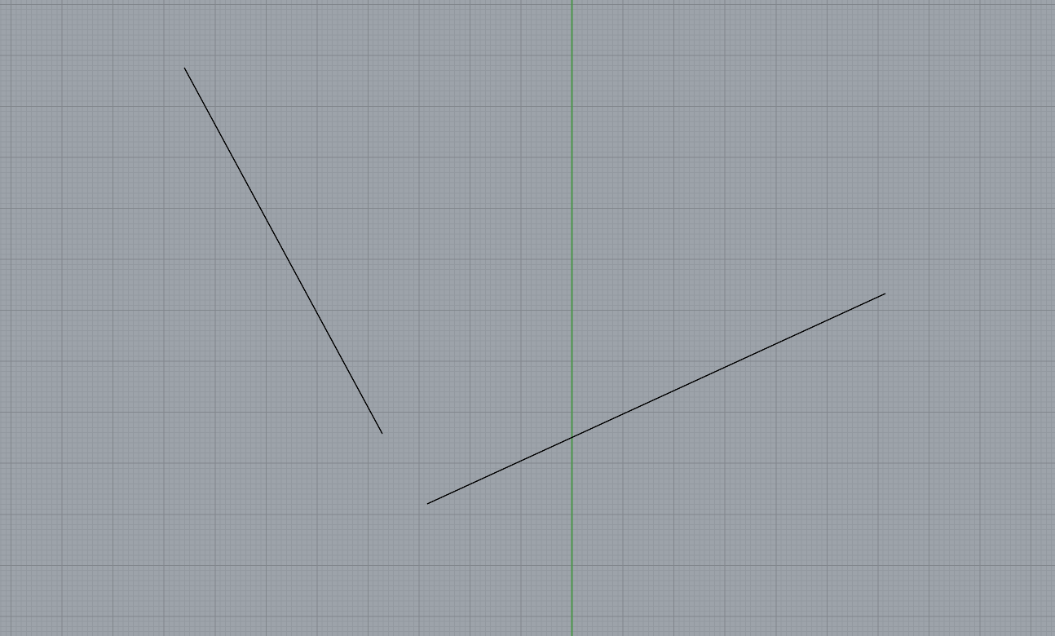
What we have learnt
Recap
Polylines
Vs Lines
18
Notes:
To avoid overloading the slides with text, use speaker notes to add more detail and prompts.
18

Slide 19
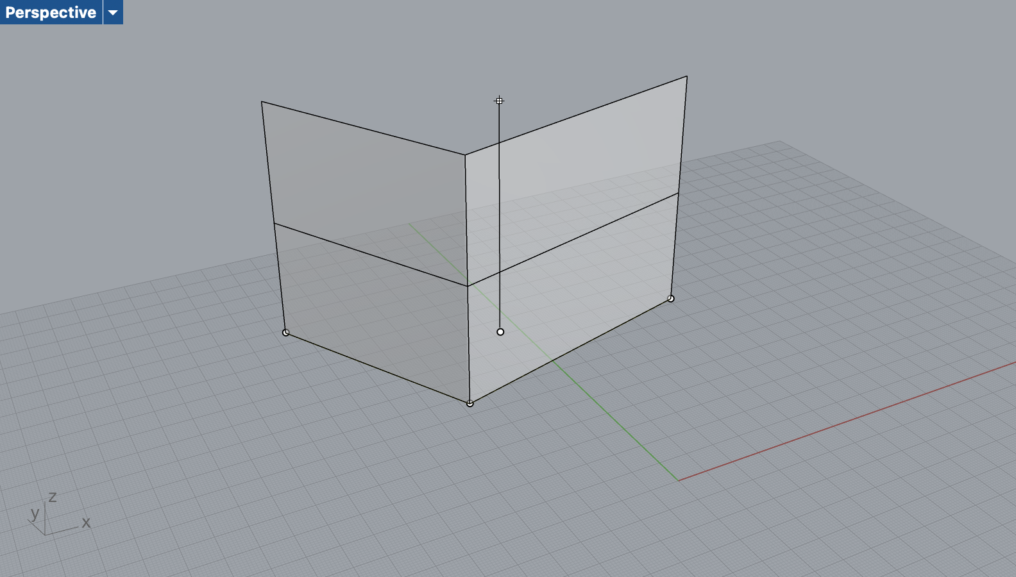
What we have learnt
Recap
ExtrudeCrv
19
Notes:
19

Slide 20
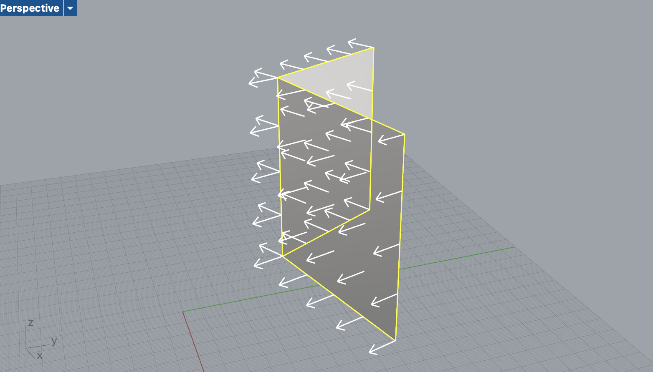
What we have learnt
Recap
OffsetSrf
20
Notes:
20

Slide 21
What we have learnt
Recap
Object types
Curves – Lines, Polylines
Surfaces
21
Notes:
21

Slide 22
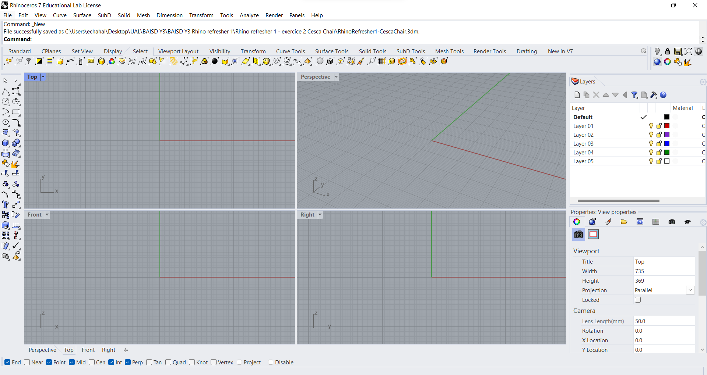
How many ways do I have to call a command?
Calling a command
22
Notes:
To avoid overloading the slides with text, use speaker notes to add more detail and prompts.
22

Slide 23
How many ways do I have to call a command?
Calling a command
23
Notes:
To avoid overloading the slides with text, use speaker notes to add more detail and prompts.
23

Slide 24
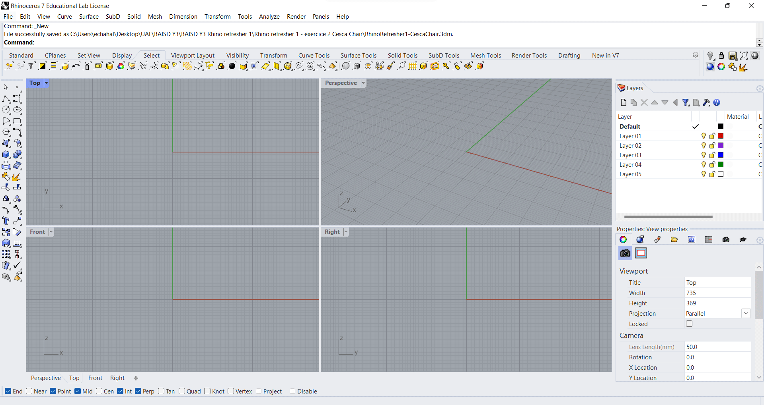
Calling a command
4 ways to call the same command
24
Notes:
To avoid overloading the slides with text, use speaker notes to add more detail and prompts.
24

Slide 25
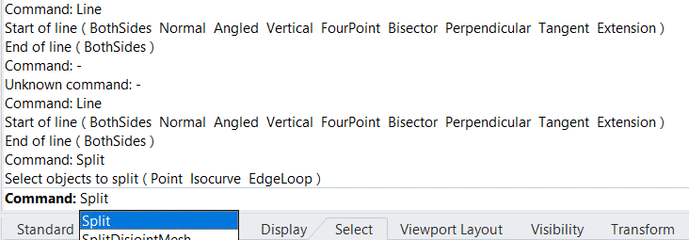
The command line
Getting feedback while modelling
Type a command
Get instructions
Change command options
Look at history
Check success of an action
Rhino 3D - Refresher Part 01
25
Notes:
To avoid overloading the slides with text, use speaker notes to add more detail and prompts.
25

Slide 26
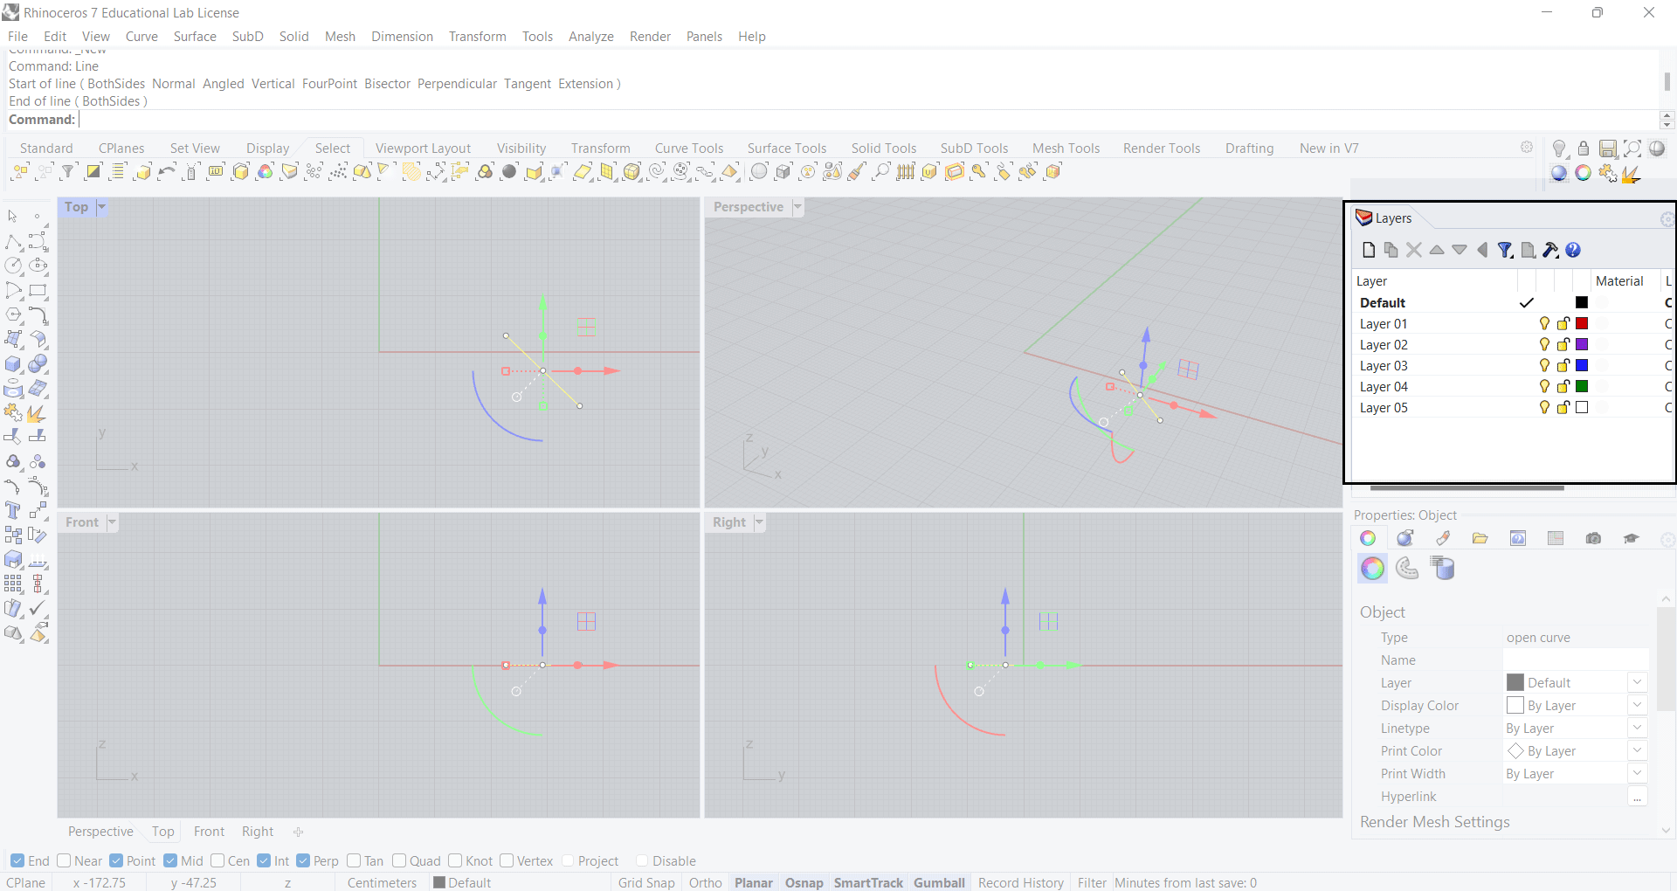
Other important features of the UI
Layers / Properties / Status Bar & Osnap / Viewports
Rhino 3D - Refresher Part 01
26
Notes:
To avoid overloading the slides with text, use speaker notes to add more detail and prompts.
26

Slide 27
Going further

Slide 28
Zig Zag chair
Going further – another strategy
I want to design this simple chair for a scene where it won’t be too visible.
Can you think of the minimum commands I could use to get this volume?
What if I wanted a close-up render on the same chair
What would you add to it to make it more realistic?
28
Notes:
To avoid overloading the slides with text, use speaker notes to add more detail and prompts.
28

Slide 29
Doubts || Questions?

Slide 30
Thank you
Eden Chahal
Specialist Technician Digital Design & Fabrication
e.chahal@arts.ac.uk

